Slide 1

Unit 2

Slide 2
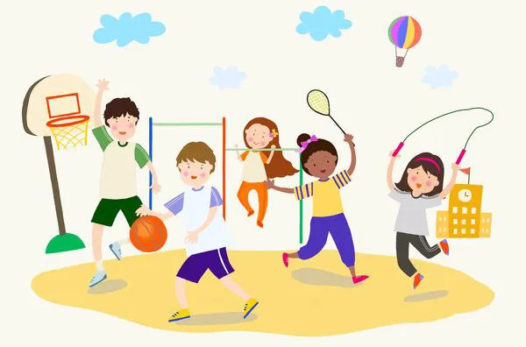
Unit 2
How often do you exercise?

Slide 3



To read and understand the article about the free time activities of No. 5 High School students
To understand and learn to describe the pie charts
To learn some new words and useful expressions

Slide 4


Role-play the conversation.
A: What do you usually do in your free time?
B: I usually ….
A: How often do you …?
B: I … twice a week. How about you, …?
A: I often … in my free time. And I … four to six times a week.
watch TV read exercise
go shopping go to the movies

Slide 5


Ask your classmates the questions and fill in the chart.
How often do you | exercise?
 | eat fruit?
 | drink milk?
 | eat junk food?
 | drink coffee?
How many hours do you sleep every night?

Slide 6

Rank these activities according to how often you think your classmates do them (1=most often, 6= least often).
watch TV
go to the movies
play computer games
exercise or play sports
use the Internet
go camping in the country

Slide 7


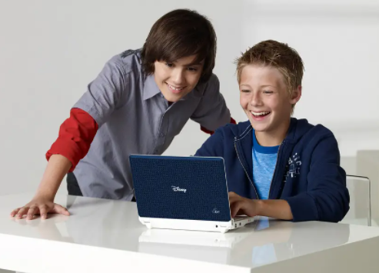
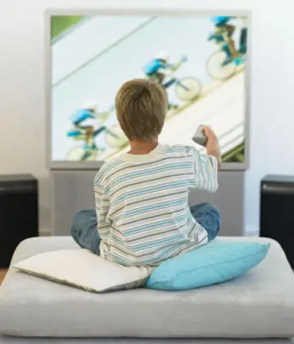
Survey
What do you do in your free time?
do exercise
use the Internet
watch TV
What activities do you think is healthy for the mind and the body?
n. 头脑; 心智
n. 身体

Slide 8
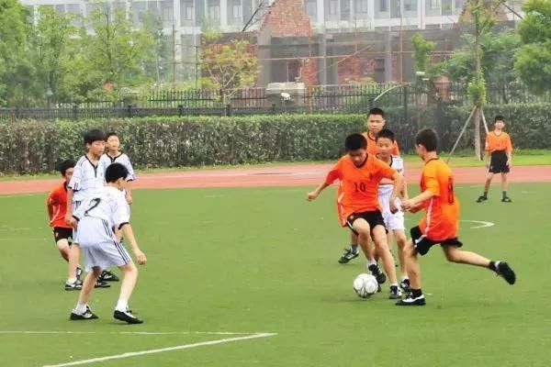


Slide 9


Slide 10

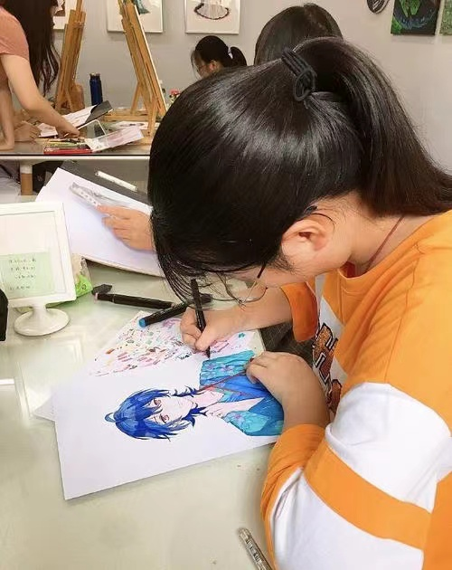
Warming up
What do you do in your free time?
do exercise/exercise
use the Internet
go camping
play computer games
go online
Let’s read a survey(调查) to konw what No.5
High School students do in their free time?
draw pictures

Slide 11

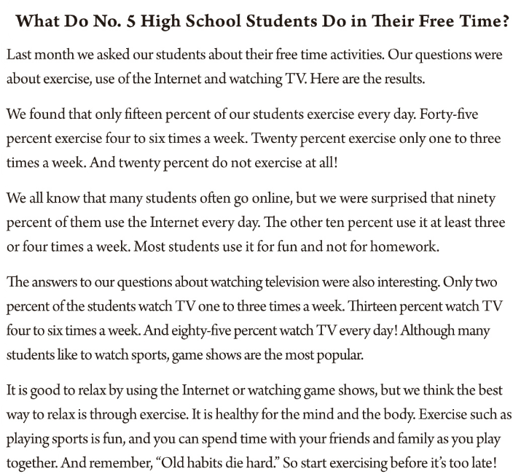
Listen to the passage and divide into three parts.
2b
主题
Topic
1
2
调查
Survey
结果
Results
3
4
结论Conclusion
5

Slide 12
Careful Reading
主题
Topic
Read paragragh 1 carefully and answer the questions.
1.Who did the reporter do the survey for?
The students of No.5 High School.
2.When did the reporter do the survey?
Last month.
3.What were the questions about in the survey?
Exercise, use of the Internet and watching TV.

Slide 13
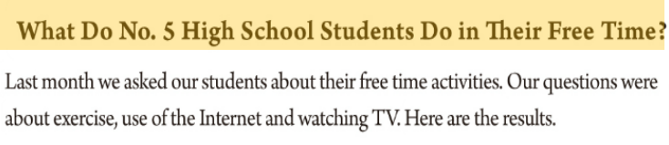
Read paragragh 1 carefully.

Slide 14

结果
Results
1.What percent of the students exercise every day?
Fifteen percent of the students exercise every day.
Fifteen percent of the students always exercise.
2.What percent of the students exercise 4 to 6 times a week?
Forty-five percent of the students usually exercise.
3.What percent of the students exercise 1 to 3 times a week?
Twenty percent of the students sometimes exercise.
4.What percent of the students don’t exercise at all?
Twenty percent of the students never exercise.
Read para 2-4 carefully,
answer the questions(2c)
and complete the pie charts(2b).
______%
every day
15
always/usuallys/often/sometimes/never
20
______%
no exercise
______%
1-3 times
a week
20
______%
4-6 times a week
45
Exercise

Slide 15

Read para 2-4 carefully, answer the questions (2c)with
and complete the pie charts(2b).
always/usually/often/sometimes/never
结果
Results
______%
3-4 times a week
10
1.What percent of the students use the Internet every day?
Ninety of the students use the Internet every day.
Ninety of the students always use the Internet.
2.What percent of the students use the Internet 3 to 4 times a week?
Ten percent of the students often exercise.
______%
every day
90
Use the Internet

Slide 16
Read para 2-4 carefully, answer the questions(2c) and complete the pie charts(2b).
结果
Results
______ %
4-6 times a week
______ %
1-3 times a week
13
2
1. How often do most students watch TV?
2. What do they usually watch?
Most students watch TV every day.
They usually watch game shows.
______ %
every day
85
Watch TV

Slide 17
Read para 2-4 carefully, what sentences can we use to tell the results?

Slide 18
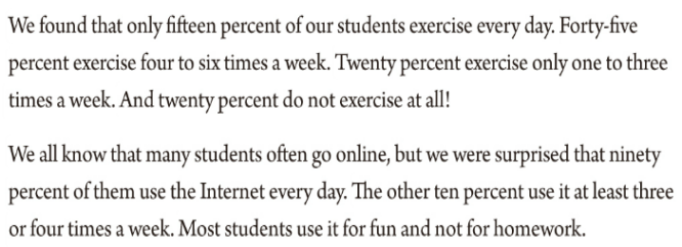
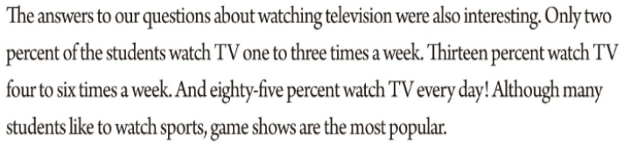

Slide 19
结论Conclusion
Read para 5 carefully, answer the questions(2c).
1. What does the writer think is the best way to relax? Why?
2. Do you think the students at No. 5 are healthy? Why or why not?
The writer thinks exercise is the best way to relax.
Because it’s healthy for the mind and body.
It’s fun.
You can spend time with your friends and family as you play together.

Slide 20
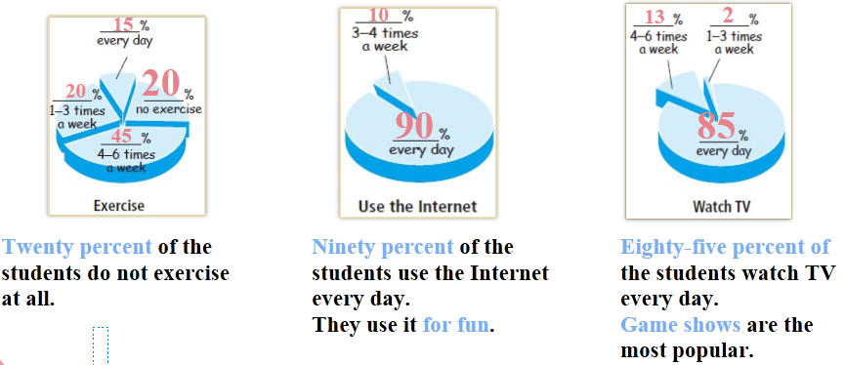
结论Conclusion
Read para 5 carefully, answer the questions(2c).
2. Do you think the students at No. 5 are healthy? Why or why not?
No, I don’t think so. Because most of them use the Internet for fun and not for homework and they watch TV too much.

Slide 21
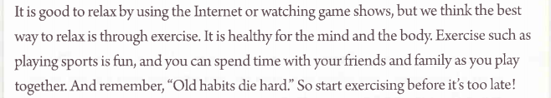

Slide 22

According to the article and the pie charts, write sentences with the percentages using always, usually or sometimes.
1. 90%(every day):
2. 85%(every day):
3. 45%(4-6times a week):
4. 10%(3-4times a week):
5. 13%(4-6times a week):
6. 2%(1-3times a week):
Ninety percent of the students always use the Internet.
Eighty-five percent of the students always watch TV.
Forty-five percent of the students usually exercise.
Ten percent of the students often use the Internet.
Thirteen percent of the students usually watch TV.
Two percent of the students sometimes watch TV.

Slide 24

主题
Subject
结果
Results

Slide 25
结果
Results
结论Conclusion
统计类文章一般由主题、结果、结论三个部分构成。

Slide 26
n. 结果; 后果
n. 百分之……
次数
adj. & adv. 在线的; 联网的

Slide 27
n. 电视节目; 电视机
conj. 虽然; 尽管; 即使
such adj. & pron. 这样的; 那样的; 类似的
prep. 以; 凭借; 穿过
例如; 像……这样
adv. 在一起; 共同
v. 消失; 灭亡; 死亡

Slide 28


Skim the passage and answer the question.
What is the article mainly about?
Skimming (略读)
This means looking quickly through a passage to find the main idea without reading every word.
A. It’s about the best way to relax.
B. The results of the survey about the students’ free time activities.

Slide 29

Scan the passage and answer the question.
What free time activities are mentioned in the passage ?
Scanning (浏览)
This means moving your eyes quickly down the page to find specific information.
Exercise, use of the Internet and
watching TV.

Slide 30

Read the article again and answer the questions.
1. What percent of the students do not exercise at all?
2. What percent of the students use the Internet every day?
Twenty percent of the students do not exercise at all.
Ninety percent of the students use the Internet every day.
3. How often do most students watch TV? What do they usually watch?
Most students watch TV every day. They usually watch game shows.

Slide 31

默读课文，摘出有关百分数的句子。

Slide 33



Choose one of these free time activities or think of your own. Then ask your classmates how often they do this activity and make a pie chart.
play computer games, read books, go shopping, draw pictures, play sports
How often do you play sports?
1-3 times a week.
How often do you read books?
Every day.

Slide 34

How often do you…? | Numbers of classmates
1-3 times a week
4-6 times a week
every day
20
10
10
play sports
______ %
every day
25
______ %
4-6 times a week
25
______ %
1-3 times a week
50

Slide 35


看电视
去看电影
玩电脑游戏
做运动
使用互联网
去野营
询问某人关于某事的情况
上网
问题的答案
watch TV
go to the movies
play computer games
play sports
use the Internet
go camping
ask sb. about sth.
go online
the answer to the question

Slide 36
百分之……的学生
例如；像……这样
旧习难改。
所以赶快锻炼起来，不要
等到来不及了！
... percent of the students
such as
Old habits die hard.
So start exercising before it's too late!

Slide 37
句型：
1. We all know that many students often go online, but we were surprised that ninety percent of them use the Internet every day.
2. It is good to relax by using the Internet or watching game shows, but we think the best way to relax is through exercise.

Slide 38


I. 根据句意及所给首字母提示，补全所缺单词。
1. Nelly finished her tests, but she can't get the r_______ right now..
2. Many people like shopping o_______. They think it helps save time..
3. There is so much you can learn from good w_______ by reading their books.
4. If you get a good night's sleep, it will keep your mind and b_______ at their best.
results
online
writers
body

Slide 39
II. 根据汉语意思，完成英语句子，每空一词。
1. 这个村大约百分之七十的儿童是留守儿童。
About ________ __________ _______ the children in this village _______ left-behind children.
2. 没有人知道那个问题的答案。
Nobody knows _______ _______ _______ _______ ________.
3. 即使退休多年后，他仍然早上六点起床。老习惯难以改变。
Even years after retiring, he still gets up at 6 a.m. _______ _______ _______ _______.
4. 她买了很多学习用品，比如钢笔和橡皮。
She bought lots of school things ________ ________ pens and erasers.
seventy percent of
are
the answer to that question
Old
habits die hard
such as

Slide 40
Ⅲ. 根据括号内的要求完成下列各题，每空一词。
1. Nick plays computer games one to three times a week. (对划线部分提问)
_______ _______ _______ Nick _______ computer games?
2. Ninety-five percent of the students in my class like music. (对划线部分提问)
_______ _______ of the students in your class like music?
3. Tina likes books like The Little Prince and Alice in Wonderland. (改为同义句)
Tina likes books _______ _______ The Little Prince and Alice in Wonderland.
How often does play
What percent
such as

Slide 41
4. By reading, we can get to know more about the world. (改为同义句)
__________ _________, we can get to know more about the world.
5. She didn't feel well, but she still went to work. (改为同义句)
_________ she didn't feel well, she still went to work.
Through reading
Although

Slide 42


According to the pie charts in 2e, write sentences with the percentages using always, usually or sometimes.

Slide 43


